Slide 2
Cisco Identity Service
Oskar Bjärne Larsson, 2024

Slide 3


Production
Amsterdam
New York
Hong Kong
Notes:
EMEA, Amsterdam. PAN, MNT & PSN. A Total of 6 Devices
AMERICAS, New York, PSN. A Total of 2 Devices
APAC, Hong Kong, PSN, A Total of 2 Devices

Slide 4
Production Environment
Hosts
Location | Device Type | Device name | DNS | IPs | Software | Role
Amsterdam | VM | nl-int-ise01 | nl-int-ise01 .mhc.molnlycke.net | 10.244.2.156 | 2.7 patch 10 | Primary PAN
 | VM | nl-int-ise02 | nl-int-ise02 .mhc.molnlycke.net | 10.244.2.157 | 2.7 patch 10 | Secondary PAN
 | VM | nl-int-ise02 | nl-int-ise03.mhc.molnlycke.net | 10.244.2.158 | 2.7 patch 10 | Primary MNT
 | VM | nl-int-ise03 | nl-int-ise04.mhc.molnlycke.net | 10.244.2.159 | 2.7 patch 10 | Secondary MNT
 | VM | nl-int-isepsn01 | nl-int-isepsn01 .mhc.molnlycke.net | 10.244.20.16 | 2.7 patch 10 | PSN , NL_INT Node Group
 | VM | nl-int-isepsn01 | nl-int-isepsn02 .mhc.molnlycke.net | 10.244.20.17 | 2.7 patch 10 | PSN , NL_INT Node Group
New York | VM | us-nyc-isepsn01 | us-nyc-isepsn01 .mhc.molnlycke.net | 10.242.20.16 | 2.7 patch 10 | PSN , US_NYC Node Group
 | VM | us-nyc-isepsn02 | NA / guestnode01 .molnlycke.com | 10.242.20.17 | 2.7 patch 10 | PSN , US_NYC Node Group
Hong Kong | VM | cn-hkg-isepsn01 | cn-hkg -isepsn01 .mhc.molnlycke.net | 10.247.20.16 | 2.7 patch 10 | PSN , CN_HKG Node Group
 | VM | cn-hkg -isepsn01 | cn-hkg -isepsn02 .mhc.molnlycke.net | 10.247.20.17 | 2.7 patch 10 | PSN , CN_HKG Node Group
Notes:
10 Nodes,
6 Amstedam
2 New York
2 Hongkong

Slide 5
Production Environment
Services
SSID Authentication
mhc!global!, Certificate Authentication
mhc!warehouse, iPSK, New Solution, not widely deployed yet.
F5 Health Checks
Infront of our PSN’s we have F5, A certain Policy allows F5’s to probe our PSN’s
Wired Dot1x
All sites are running Dot1x in OpenMode, some sites have it in ClosedMode.
Dot1x Then MAB.
Sales Offices recieves DACL limiting their access to certain backend networks located in VDC:s.
If all checks fails, then access to our PXE-servers is granted.
TACACS
All Network devices is using Tacacs, The PSN in NL-INT is the only PSN that has the Tacacs Role.

Slide 6
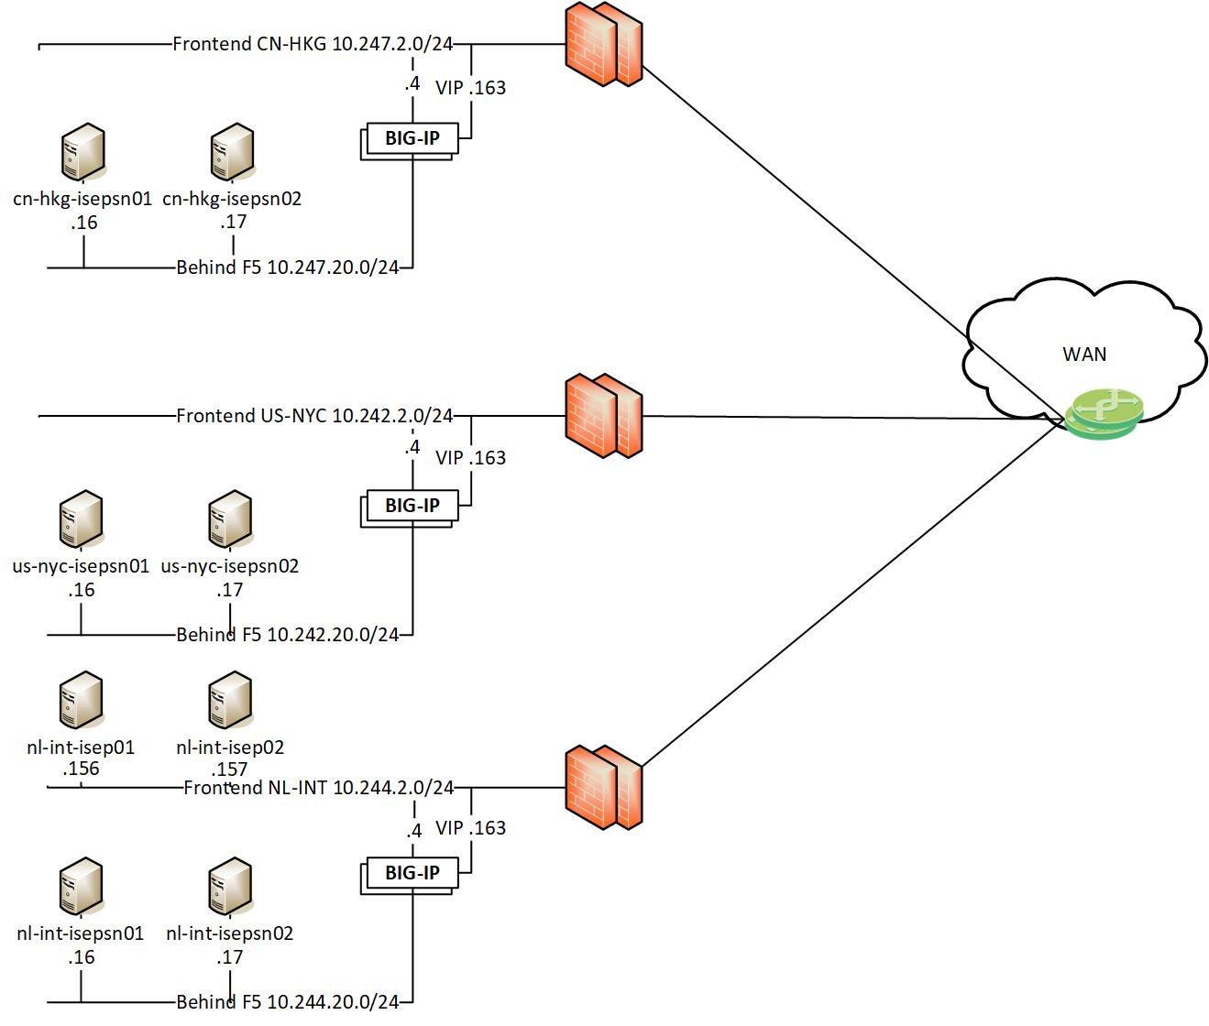
Production Environment
Topology
Notes:
OBS, ise03 & ise 04 in amsterdam is not pictured.

Slide 7
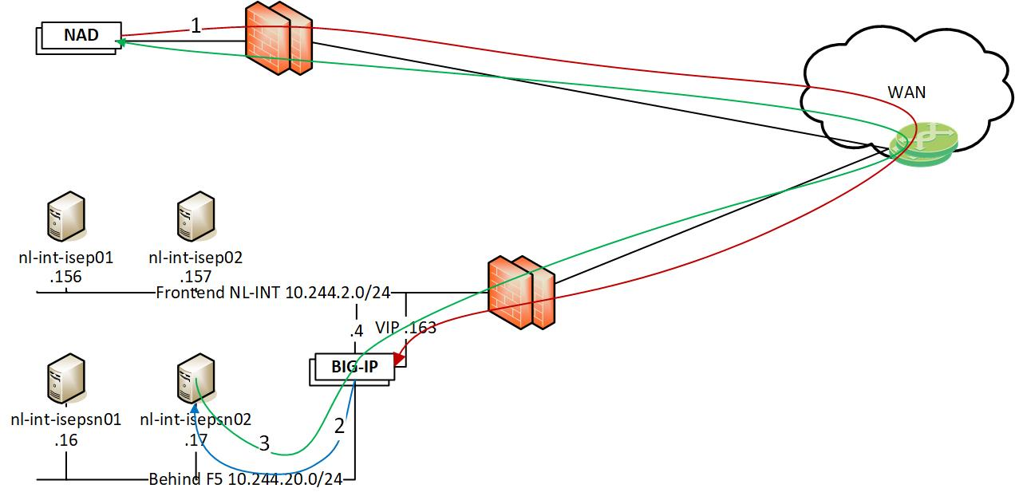
Production Environment
Flow
Radius/Tacacs access request from NAD (WLC/Switch) to VIP on F5 (Tacacs is only avalibe on the nl-int PSN’s)
The request is load balanced between the nodes, in this case to nl-int-isepsn02
The PSN node responds to the NAD and are source NATed behind the VIP on the way back. (This is also the same flow for CoA. The PSN sends the CoA to the NAD and are source NATed behind the VIP)

Slide 8
Guest
Amsterdam
Notes:
EMEA, Amsterdam. A Total of 2 Devices.

Slide 9
Guest Environment
Hosts
Location | Device Type | Device name | DNS | IPs | Software | Role
Amsterdam | VM | nl-int-isegst01 | nl-int-isegst01.mhc.molnlycke.net | 10.244.20.11 | 2.7 patch 10 | Primary PAN Secondary MNT PSN
 | VM | nl-int-isegst02 | nl-int-isegst02.mhc.molnlycke.net | 10.244.20.12 | 2.7 patch 10 | Secondary PAN Primary MNT PSN

Slide 10
Guest Environment
Services
Sponsor Guest Portal
Guest can register an account for wireless guest access.
Employees can use their AD credentials for guest access for their BYOD Devices.
F5 Health Checks
Infront of our PSN’s we have F5, A certain Policy allows F5’s to probe our PSN’s

Slide 11
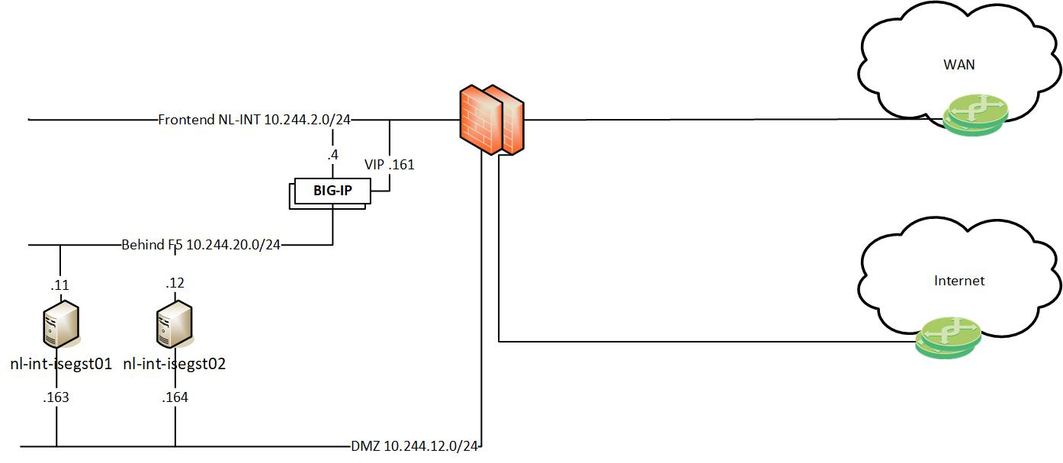
Guest Environment
Topology

Slide 12
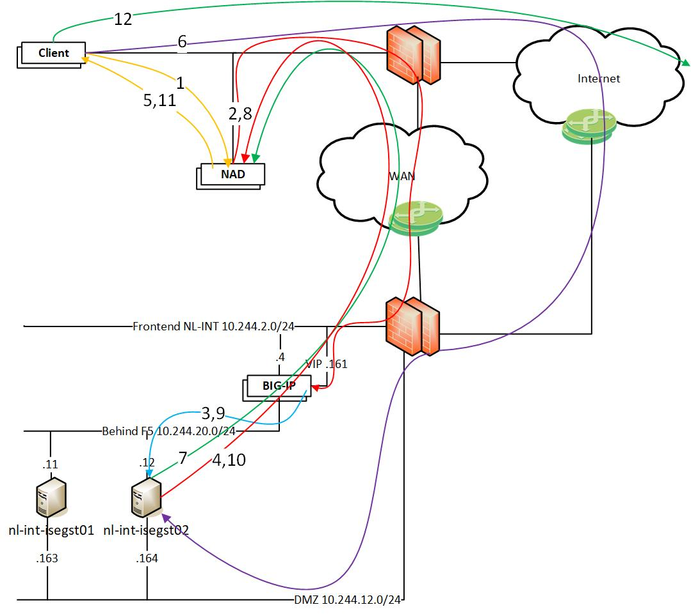
Guest Environment
Flow
Guest connects to the guest network
Radius request is sent from the NAD to the VIP
The request is load balanced between the nodes, in this case to nl-int-isegst02
The PSN answers the radius request with a web-redirect and an ACL to be applied to the client.
The client gets the web-redirect and is applied an ACL that only allows dns and communication
with the public side of the PSN
The client is directed with the web-redirect to the public interface on the PSN on port 8445 and gets there over the internet.
When the client has authenticated via the guest web portal a CoA is sent to the NAD.
The NAD redoes the authentication for the client and sends a radius request to the VIP.
The F5 load balance the request and with the sticky configuration the same PSN will get the request.
The PSN knows the client and sends a correct access-accept with a guest ACL back to the NAD.
The client is allowed on the network and is applied a guest ACL that blocks internal networks.
The client can now surf the web.

Slide 13
The End

